Slide 1
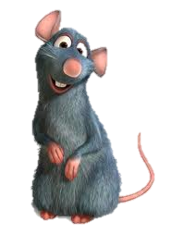
Combined sequence based and genetic mapping analysis of complex traits in outbred rats
Nature Genetics 45, 767–775 (2013)
Baud, A. et al.
Rat Genome Sequencing and Mapping Consortium
Presented by Alex Gileta
Hailing from the Palmer Lab

Slide 2
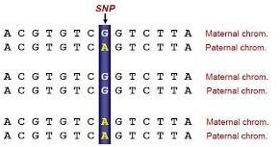
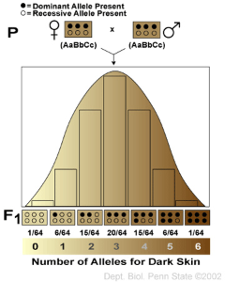
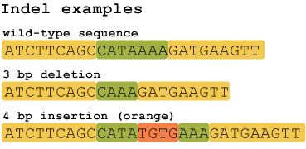
Genetic Variation and Complex Traits

Slide 3
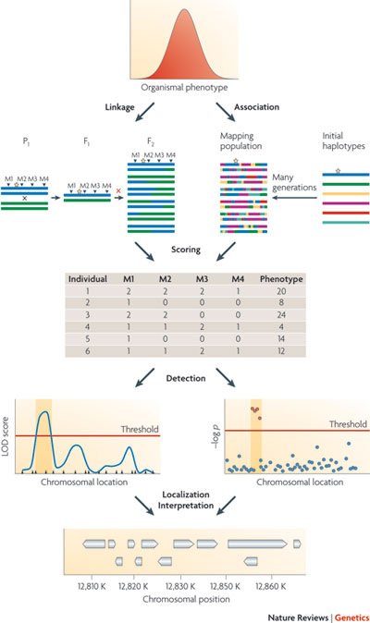
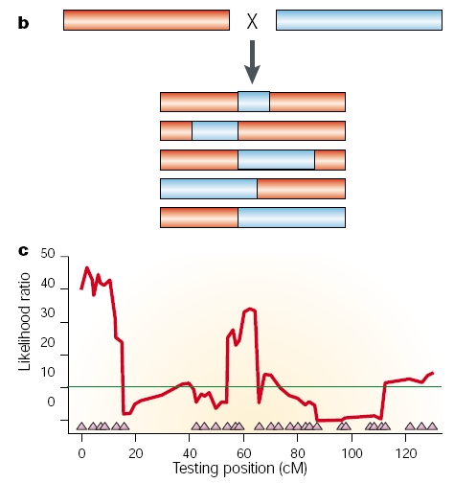
QTL Mapping
Nature Reviews Genetics 10, 565-577 (August 2009)

Slide 4
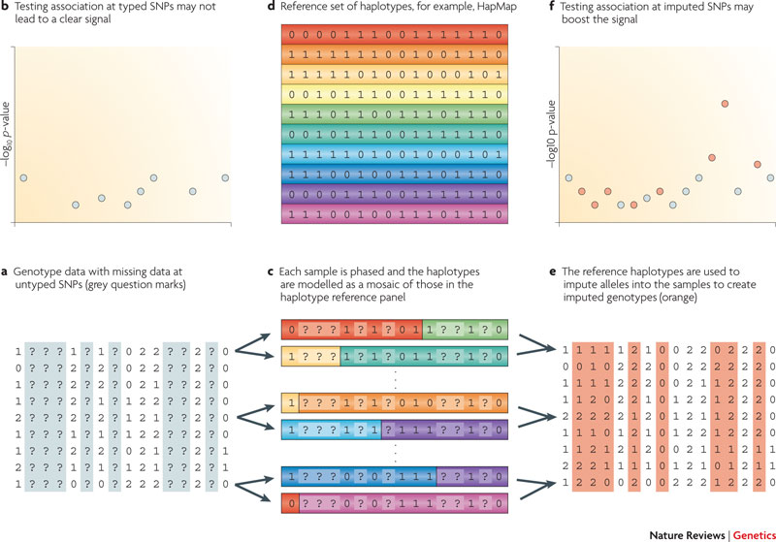
Imputation
Nature Reviews Genetics 11, 499-511 (July 2010)

Slide 5
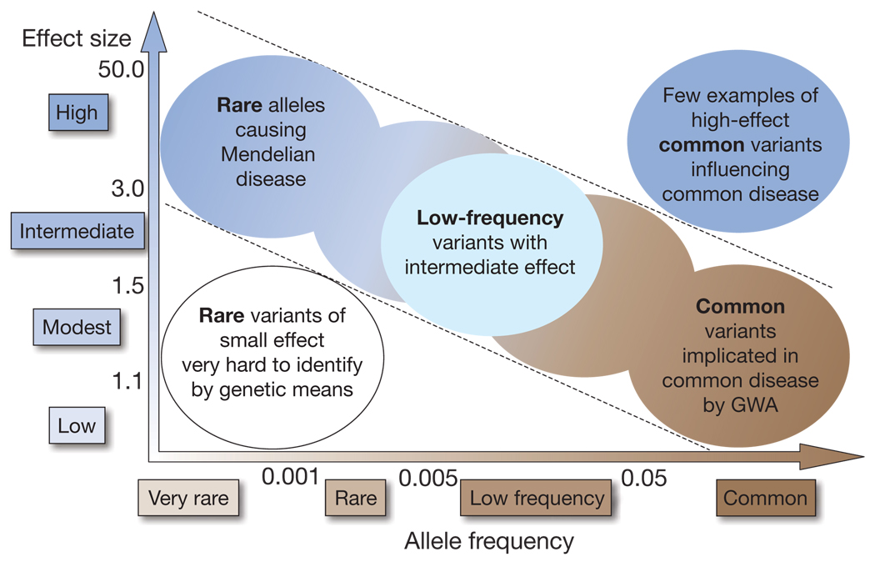
Issues with GWAS in Humans
Increasingly large sample sizes
Small effect sizes
Rare variants
Inaccessible disease-relevant tissues
Environmental variation
No potential for functional characterization
Manolio et al. Nature 461, 747-753
Notes:
---Larger and large sample sizes - small fraction of phenotypic variance whereas in mice, only a few hundred are needed to find variants that can account for over 50% of the total phenotypic variance
---Uncontrolled environmental influences --- environmental similarities or correlation between genotype and environment --- gene x environment interactions. Association may not be replicable in different environments due to variable penetrance/expressivity
---Rare variants hard w/ standard variant calling approaches and with such low frequencies, are difficult to attribute any appreciable effect.
---Lead to unknown rare haplotypes that make haplotype tests difficult in humans. The excess of variants however is what allows us to get extremely well-defined QTLs

Slide 6
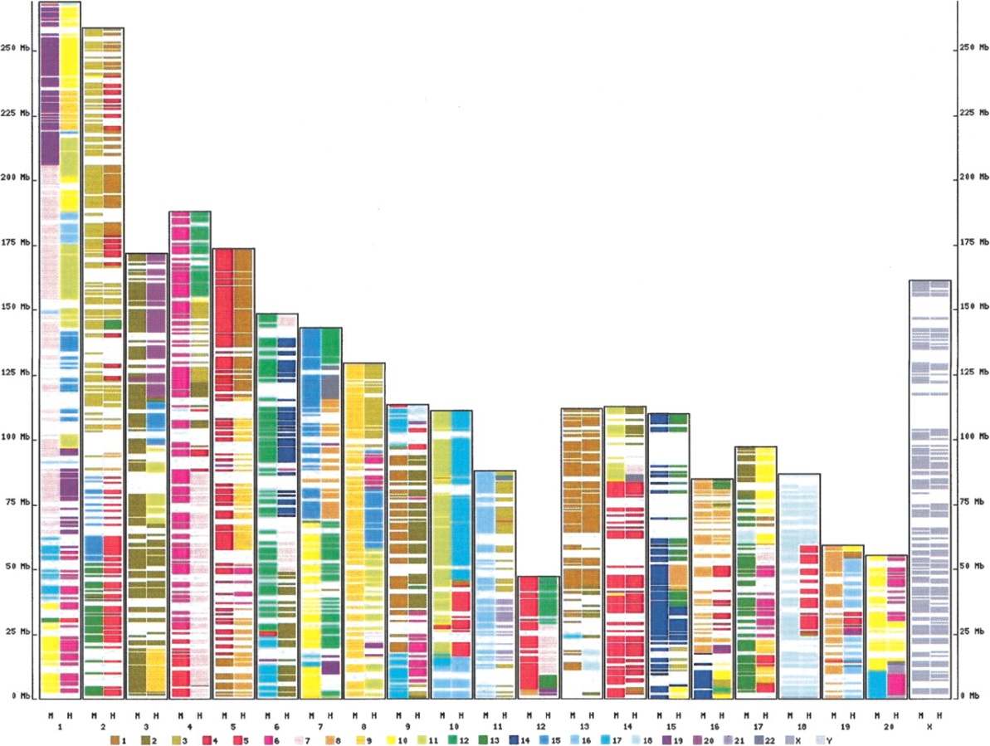
Model System Solutions
Small sample sizes
Accessible disease-relevant tissues
No environmental variation
No rare variants
Easily genetically manipulated
Largely syntenic
Exon-based map of conserved synteny between the rat, human, and mouse genomes.
Cold Spring Harbor Laboratory Press
Brudno M et al. Genome Res. 2004;14:685-692
Notes:
Due to the inbred structure and high LD in mice/rats, samples sizes for mouse and rat studies can be significantly lower and still account for over 50% of the variation in a trait.
X axis is for rats, columns are for human and mouse respectively

Slide 7
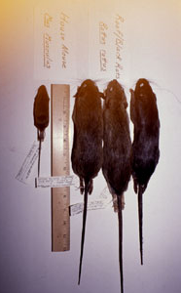
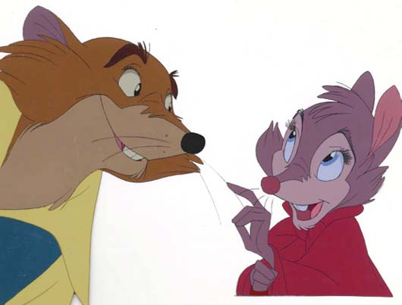
Mice vs Rats
Smaller/cheaper
Historic ease of genetic manipulation
Well studied
Larger
Phenotyping
Surgery
Tissue Samples
“Smarter”
Docile
Heart rate
Drug metabolism
Genome size (2.75)
HS stocks homogeneous
History
Disease overlap with humans
Notes:
Wealth of Physiological and pharmacological data available for it. Often drugs are tested in mice for efficacy and than rats for safety because rats respond more like humans to drugs.
80 genes that are implicated in human disease were found to reside in variable copy number regions in both human and rat

Slide 8
The rat Heterogeneous Stock
QTLs down to 1Mb level
Accuracy of imputation
Well-defined haplotype space
http://openwetware.org/images/1/1f/AmelieBaud_RatHS.pdf
Notes:
--Established in 1980. 8 inbred founder lines chosen for the high degree of genetic diversity between them
--representative of the segregating variation found in most commonly used lab rat strains.
--Colonies had to remain large to avoid drift and fixation. Outbreeding keeps heterozygosity high, breaks up LD efficiently.
--Allows resolution of QTLs to megabase
--Ease of imputation given sequence data from progenitor stocks
--Well-defined haplotype space that allows determination of whether association is with a single sequence variant or a haplotype. (Not possible in natural populations where there is a large number of unknown rare haplotypes.)

Slide 9
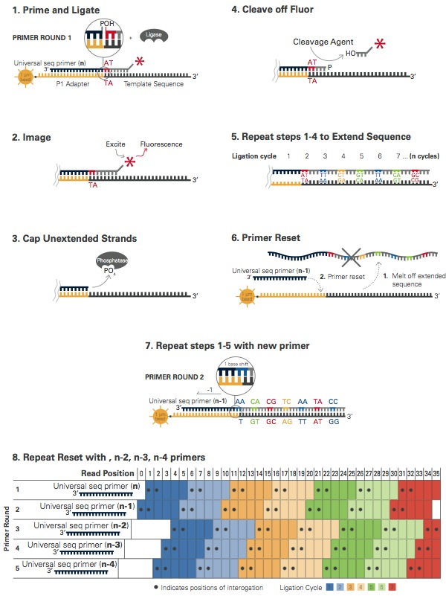
Paired-end SOLiD sequencing – 8 founders
> 22x Coverage
Notes:
--22x coverage means that on average, each basepair in the genome got sequenced 22 times, so we have pretty high confidence about the calls
--Called variants independently from each strain compared to the reference
--Indels < 10bp
--Also had a control to measure their error rate, the LE/Stm strain for which they had BACs that they were able to perform capillary sequencing on. Confirmed by PCR-based resequencing.
BWA/SAMTools for SNPs
DWAC-Seq v. 0.56 for indels
1-2-3-SV for discordant pair mapping

Slide 10
7.2 million SNPs,
633k indels,
44k structural variants
False pos/neg rates:
SNP – 2.7% & 17.2%
Indels – 2.2% & 16.7%
Structural – 16.7% & 65%
Notes:
--Accessible genome was defined as not overlapping a simple tandem repeat region or low-complexity sequence…..and not covered by more than 150 reads, and average mapping quality of at least 40.
--BN/SsN was a substrain of the reference, so that’s why it’s drastically lower
--29% of SNPs were private - Unique haplotypes are relatively common – this is good for mapping studies, allows us to impute much more easily if there are more private SNPs.

Slide 11
Notes:
---Diversity between all strains was similar. Compared to rat BN strain and mouse C57BL6
---More homogeneous diversity than the mice used to establish the mouse HS, but overall less diverse by 3million SNPs.
In the HS stock alone, there are 1.6million more SNPs in the mouse stock than rat stock. (4.4 vs 2.8)
A) Low diversity = consecutive windows of less than 13 SNPs in a 100kb region
B) 157 is the peak – more divergent regions
---Can see the mouse HS has a much larger number of long low diversity segments ….or in other words, long tracts of identical haplotype between strains. Not as good for haplotype mapping.

Slide 12
Genotyping Array
RATDIV
Reduced representation sequencing with REs
803,485 SNPs chosen from a pilot utilizing 2.1 million SNPs from 13 inbred lines (none from HS)
560,000 passed QC in founders
SOLiD vs RATDIV – 99.98% concurrence
Genotyped 1407 HS rats
265,551 markers used for mapping
Discarded for standard QC, if monomorphic over all founders, or if founder was heterozygous.
Notes:
NspI and StyI
MAF mean 22%
LD decayed to 0.2 within 1Mb

Slide 13
Phenotypes
Notes:
160 phenotypes total
Elevated zero maze, open field in novel cage, tw-way active avoidance acquisition

Slide 14
Single-point vs. Haplotypic Mapping
http://openwetware.org/images/1/1f/AmelieBaud_RatHS.pdf
Notes:
Evidence of association will now be reduced because the marker fails to partition the genotypes into two equally contrasting groups.
But the haplotypes that are defined by the markers p and q distinguish all four strains and so are surrogates for the efficient marker m. Therefore, multi-point haplotype-based mapping is generally more powerful than single-point mapping
However, the strain distribution patterns of neighbouring markers rarely distinguish between all founder strains, so instead we compute the probability that an animal is descended from a given pair of strains at a particular locus.

Slide 15
QTL Mapping in HS
Varying relatedness in HS
Siblings, half-sibs, cousins, etc.
Mixed Models
Assume trait is normally distributed
Genotypic similarity matrix
Resample Model Averaging
Non-parametic (binary, negative binomial)
Consistency across multiple QTL models
Fitted on subsamples of the mapping population (like bootstrapping)
Haplotype association
R HAPPY
Descent probabilities averaged over 90kb windows
Notes:
---False associations due to relatedness and correlations between wide-spread markers
---Mixed models control for false associations by assuming the phenotypic correlation between individuals is proportional to their genome-wide genetic similarity.
---Resample model averaging techniques, markers compete to explain phenotypic variation in
multilocus models. Uses inclusion probabilities (the fraction of resampled models containing a given QTL) Basically forward selection of QTLs to include in your model over and over and over and the theory is that the ones that will most often remain in the model are those with the most influence on your trait
---Averaging descent probabilities over windows allows you to smooth over outlier markers for instance that may throw off haplotype inference

Slide 16
Mixed Model - Haplotype
y = phenotypic value of rat i
β = regression coefficient for covariate c
x= covariate value of c for rat i
T = effect size of one copy of a given haplotype from strain s at locus L
P = expected number of haplotypes of type s carried by rat i at locus L
U – random genetic effects
Ε – random error
Ui – contains genetic covariance matrix
Estimated by IBS
Estimating T
Standard linear model after transformation
Notes:
P – 0 to 2

Slide 17
QTL Mapping Results
Resample and Mixed Model
355 QTLs in 122 phenotypes
Explained on average 5-6.5% of phenotypic variance
Skewed distribution
QTLs explained 42% of heritable variation on average
Confidence interval – median of 4.5 Mb
~40 genes
Notes:
Used both methods to map all traits and reported the results from the one that performed the best for each trait at the 10% FDR
Joint effect sizes actually are greater than the estimated heritability is that they excluded the genetic random component from the mixed model when calculating the joint effect. Prevents them from underestimating effect sizes by accidentally accounting for the phenotypic variance attributable to a given SNP in the relatedness matrix, but in turn they overestimate the effect sizes because they are attributing all phenotypic variance just to the QTLs and the error component.
Now this is commonly controlled for by leaving out the chromosome the QTL is located on in the estimation of the effect. This allows for control of the IBS of individual rats in the study, while avoiding accounting for the effect of the QTL by including SNPs in LD with your SNP, and therefore “stealing” some of its effect.

Slide 18
Merge Analysis
Assume single variant is causal
(1) Is the variant associated with the phenotype?
standard test of association
(2) Is its association as significant as the association in the haplotype-based test in the locality of the variant?
Models are nested, should be comparable
Significance will be greater – fewer degrees of freedom
Calculate d = max log(P.merge) – max log(P.hap)
Can’t distinguish SNPs with identical distribution
Significance of haplotype comes from genome-wide test, SNP from only within the QTL?
Notes:
---V is a sequence variant in interval L and M_{V} is the merge matrix for the variant, formed by summing those columns of P_{L} that carry the same allele at V (each column of P_{L} represents one founder strain)
---From a statistical point of view, there is no difference between two variants with the same strain distribution pattern at a locus; they will give the same merge analysis result.
---Because models (2) and (3) are nested, the best possible fit (in terms of variance explained) is obtained with haplotype model (2). If the QTL arises from variation at a single variant V, the fit of merge model (3) for variant V will be as good as the fit of model (2), and its significance will be greater, owing to the fewer number of degrees of freedom (for a diallelic variant, there is 1 degree of freedom for the merge model compared to the 7 degrees of freedom for the haplotype model).
Different from a single-variant test in this paper because this is an imputation based method whereas the single-variant test is used simply for typed SNPs
compared the distributions of d from the different simulation sets to determine the probable genetic architecture of the QTLs.

Slide 19
Merge Analysis
B. Yalcin, J. Flint, & R. Mott - Genetics 171: 673–681 (October 2005)
Notes:
SDPs on bottom left
Questions and answers for this slide:
"On slides 19, you will see a plot of the log(p-values) for the haplotype test (red line) vs. the merge test (black dots). The question that was asked was why, in the 3rd window of the plot, all the black dots surpassed the haplotype level of significance, and there were none that fell below? If they were the only SNPs in that window, and they all tested at the same significance level, shouldn't the haplotype rise to the same level?
First of all, this is a great question, and I apologize that it caught me off guard during the presentation, but the answer is actually pretty simple. It's because of the difference in degrees of freedom that I had mentioned. The merge model only has 1 degree of freedom whereas the haplotype model has 7. So the p-value for the merge test will be higher for those 4 SNPs even if they perfectly define the haplotype (meaning those 4 are in complete LD and make up that haplotype block), simply because of the way significance is being statistically tested.
If we look at the second window on the plot, where the 5 SNPs fall perfectly on the line of the haplotype significance bar....that would give you the misconception that the SNPs are performing equally to the haplotype. This is not actually the case. The strain distribution pattern of each is probably a little off for each of them, so individually none of the 5 SNPs perfectly tag the QTL as well or better than the haplotype. If that were the case, then you would expect that the SNPs would all fall above that line as happening in the 3rd window.
In summary, the plot is misleading because it is plotting results from two different tests with different degrees of freedom on the same axis. What the authors SHOULD have done was plot the relative results of the association accounting for the different in the degrees of freedom. That way, if the SNPs performed equally as well as the haplotype, then they would fall on the same line...if they performed better, they would be above the line....and if they were worse separately, they would be below."
-Alex

Slide 20
Why do merge analysis?
Rules out causal role for majority of variants
90%+
Identifies some candidates in coding regions
Eliminates genes far from candidate variants

Slide 21
Rules out causal role for majority of variants
131/343 (38%) of QTLs had candidate variants
28 single gene with candidate
CTNND2
Shank2
Only candidate variant in 82 genes within QTL
Notes:
-Variants with the same SDP are not confined to a simple haplotype block and can therefore be throughout most of the region of a QTL, because only relies on the SDP
Catenin delta2 – anxiety related phenotype
Found in complexes with cadherin cell adhesion molecules at neuronal synapses
Shank2 – heart weight phenotype
-encodes synaptic protein not previously associated with cardiovascular physiology
-

Slide 22
Identifies some candidates in coding regions
Identifies some candidates in coding regions
Notes:
Those affecting protein structure are more likely to be functional/causal
Tested 43/91 of the nonsynonymous candidate variants with available protein structures. 9 of these had evidence that protein structure might be altered.
C) –Affects antibody recognition of CD45RC
D) One of these was Tbx21 – phenotype was proportion of CD4+ T cells with high expression of CD25, and it is believed the mutation alters the DNA-binding characteristics of the protein. Has been previously implicated in the genetic control of regulatory Tcells which have high surface expression of CD25, and therefore it may indirectly regulate CD4+ and CD8+ T cellfrequencies through Sin3a
E) ABCB10 mitochondrial transporter induced by GATA1 during erythroid differentiation. – crystal structure shown – phenotype mean red blood cell count. Threonine changed to methionine and looks to change the polarity of the channel and potentially alter transporter function

Slide 23
Merge Analysis: Not Enough?
212 QTLs (62%) w/o candidate variants
Why so few?
(1) Causative variant not sequenced
Test all SDPs by merge analysis
Only 44/212, leaving 168 (49%)
(2) Haplotype mapping biased towards QTLs lacking single causal variants
Simulations to test 3 scenarios
Single
Multiple
Haplotype
What about at QTLs where a single variant is highly likely to be causal?
Cis-eQTLs
1,398 hippocampus (97% found SCVs)
7,464 Trans-eQTLs however…..hmm.
Notes:
Not all variants were tagged by a nearby variant with an identical strain distribution. Generated every possible strain distribution diallelic and triallelic variants within the QTLs without candidates by using merge analysis. 44 had diallelic ones they could “make” causal.
Biased to those without candidate variants. Tested this with simulations where they tried different genetic architectures where 5% was attributable to the QTL, 20% random genetic effect, and 75% uncorrelated error.
What they did find was that simulating multiple causal variants on different haplotypes did reduced the frequency at which any single variant exceeded the maximum haplotype log (P)
Conclude that the presence of multiple causal variants can at least in part account for the inability to identify candidate causal variants.

Slide 24
Merge Analysis: Not Enough?
Why so few?
(3) Haplotype test winner’s curse?
Merge performs well in simulation, what about across genome?
Merge
152 different than haplotype
16% fewer overall
Only 9% w/o candidate
Combined, 44% w/o single causal variant
(4) Merge underestimates significance?
Compare to single-marker test at genotyped SNPs
0.9 r2 correlation between log(P)
Should merge have unique results from haplotype?
Notes:
Only had run merge analysis on QTLs identified in the haplotype based test up until this point, and haplotype based tests may be biased towards loci without candidates due to winner’s curse??? The winner's curse in genetic association studies appears as upward bias in the estimated effect of a newly identified allele on disease risk when the study design lacks sufficient statistical power.
The two methods did not identify the same SNPs, and additionally merge identified several fewer, but 91% of them had candidate variants underlying them. Haplotype is most likely overestimating the number of QTLs without candidate variants and merge is underestimating it. So the best idea is to approximate it from both tests. Combined, 44% w/o SCV. So winner’s curse can’t be accounting for all the missing SCVs.
Problem, if the addition QTN is on a different SDP than the one we’re concerned with (aka not in high LD) then merge will fail to find the QTN, however if they are on the same SDP it will be difficult to say it was more than 1. Seems unlikely that a given haplotype would be significant than, if the multiple SNPs that form it are in different SDPs, the haplotype wouldn’t work as efficiently either I feel???
4) High r2 correlation indicates that performs as well at SNP-based test at the genotyped SNPs. But these were only genotyped SNPs whereas I believe merge analysis is throughout the paper being called a sort of imputation-based method, and therefore may simply be able to test more variants and therefore have an increased number of results. If you had done imputation for the SNP-based test, would it have out competed the merge analysis?
Maybe be losing some of the associations in SNP-based method because of differences in multiple-testing, differences in threshold that was used for the SNP-based mapping compared to merge analysis. Lack of testing the imputed markers of course. So merge will have some unique ones for sure and should encompass SNP-based, but SNP gets some unique ones due to possible different thresholds
Some unique SNP-based associations may be due to smaller effects that can only be picked up by an individual test, harder to find in haplotype based ones….or differences in SDP that throw off the haplotype.

Slide 25
Concordance Between Species
QTL overlap between mouse-HS and rat-HS?
38 common measures/model
CD4+/CD8+ cell ratio
KEGG
Both were enriched for
QTLs associated with
B cells/total WBC pop.
Sampling?
Notes:
Only 1 overlap at 10% FDR, none significant
8 overlap at 20% FDR, only 2 significant
Kyoto encyclopedia of genes and genomes – not really enough genes per phenotype to truly do enrichment analysis….
Interesting that there is almost no overlap between the QTLs identified for mice and rats considering the degree of synteny between their genes.
Which QTLs you discover really depends on the sequence variation that went into the HS stocks, so could be that you sampled sets of variation that is more helpful for certain traits than others in the mice vs rats.

Slide 26
Conclusions
Discovered 355 QTLs in 122 phenotypes
TBX1 & ABCB10 –
Nonsynonymous SNPs
Exonic
Could alter protein function in T cell regulation and red blood cell differentiation respectively
Median explained heritability – joint QTLs
Rat – 39.1% / Mouse – 32.2% / Human – 10%
Different allele frequency spectrums & # SNPs
Merge analysis may help identify QTVs
Many QTLs lack candidate variants (44%)
Type loci in humans of QTLs discovered in rats?
Rats are cool.
Notes:
Tbx21 – phenotype was proportion of CD4+ T cells with high expression of CD25, and it is believed the mutation alters the DNA-binding characteristics of the protein.
Humans plagued by rare alleles (MAF<1%) whereas HS stocks are relatively uniform in distribution of MAFs.
Despite more variants in HS mice, we see greater heritability being accounted for in rats…..so greater sequence variation in mice does not result in increased heritability…..why would it??
Multiple causal variants to blame?

Slide 27
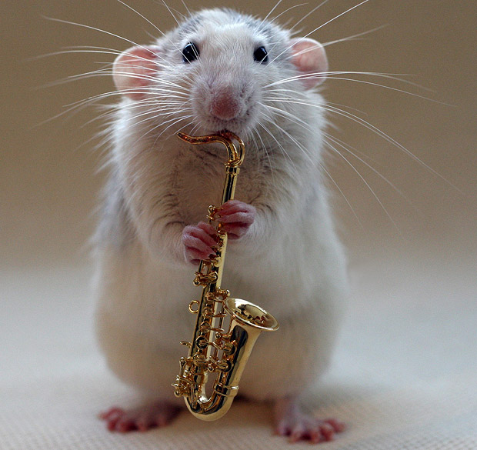
Thanks for Listening!
Acknowledgements
Matthew Stephens
Abraham Palmer
Peter Carbonetto
Palmer Lab
Gerald Bothe
Shyam Gopalakrishnan
GRTG Training Grant
P50

